Slide 1
Resource Allocation Model for Disaster Relief Operations with Information Crowdsourcing
Project creator : RAGHUL J
B.Tech IT

Slide 2
ABSTRACT
A catastrophic event and awful function require a brisk reaction that can decrease harm and spare lives, satisfying the essential humanitarian necessities of the influenced populace Public or global associations and organizations might be started to give help yet neighborhood offices need to go about as quickly as time permits since they know about the geological area just as the nearby states of the influenced zones. Viable coordination of catastrophe help is regularly significant, especially when assets are restricted in the nearby offices and the requests are more. In such conditions, it turns into a provoking position for the offices to convey assets with the goal that the assets are ideally utilized. This project is started to address the difficult certainty by presenting the idea of need measures for requests. In such a way, the positioning of the regions dependent on resources necessity for a catastrophe situation. The system handles Resources for the affected populace and optimal Resource Allocation

Slide 3
EXISTING SYSTEM
In Existing system resource is not allocated optimally and it does not connects donator and distributor to distribute the resource. In this system Resource get’s waste and not efficiently utilized & authorized. In this system it does not have any authentication process so fake donator and fake distributor can arise
DRAWBACKS:
Resource is not allocated optimally
It does not connect donator and distributor.
It is not authorized.
It gets fake information.

Slide 4
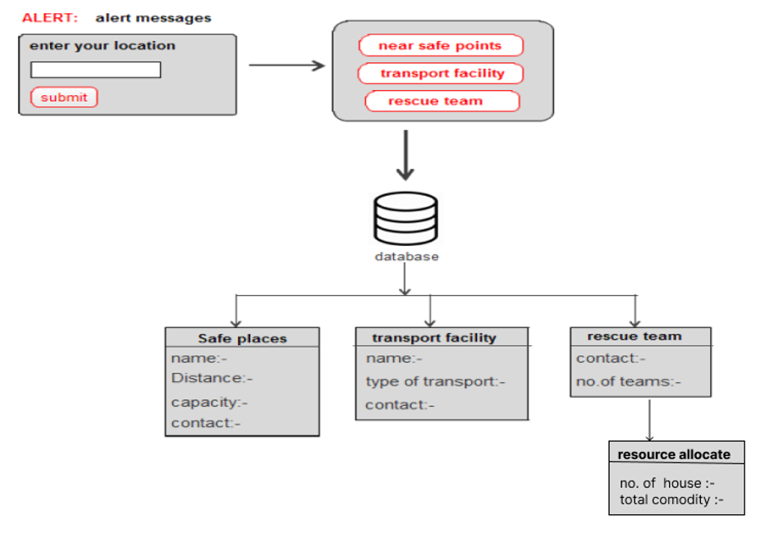
EXISTING ARCHITECTURE

Slide 5
PROPOSED SYSTEM
The proposed system is post-disaster relief resource allocation using website.it is optimized with resource allocation algorithms. It works as bridge for donator and distributor. Resources are efficiently utilized optimally. Authentication done by admin only ,where authorised donors and distributor are allowed to perform their action .
ADVANTAGES:
It an optimal resource allocation.
It helps to connect donator and distributor.
It helps to utilize resources efficiently.
It gets authorized donators and distributor.

Slide 6
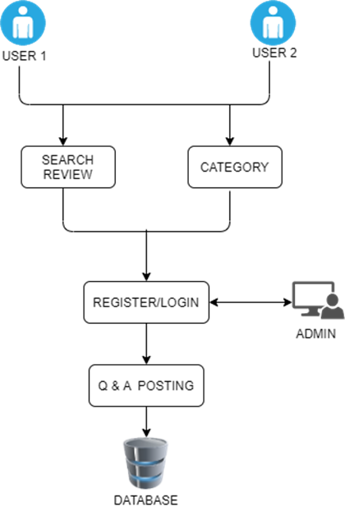
PROPOSED ARCHITECTURE

Slide 7
MODULES:
Login /registration- Module.
Admin –Module.
Donor- Module.
Distributor-Module.
Resource List-Module.

Slide 8
MODULES DESCRIPTION:
Login /registration- Module:
Registration module is used to register the details about the Donor/Distributor. That contain create a unique name and password. That also needs a full name of user and email id of user for authentication.
The basic module login is used in web page. The module has username and password. That will be verified with database and allow to login to the web page.
Admin–Module:
This module is used to verify the Donor/Distributor, its helps to prevent from the unauthorized problems. Admin indicates the indication for perfect and correct reviews

Slide 9
MODULES DESCRIPTION:
Donor -Module:
The donor module is used for the donation purpose after the disaster . This module is helps to donate some resources to the victims via distributors. Donors donate any resource to affected people .
Distributor-Module:
The distributor module is used after the donor donated their resource. distributer can get the resource details via our web page.it can helps the resource given to the affected people by the distributor.

Slide 10
MODULES DESCRIPTION
Resource List Module:
This module contains list of resource what the basic of affected people needed like foods, medicines, bed sheets and living places safely. This module shows the requirements of affected areas

Slide 11
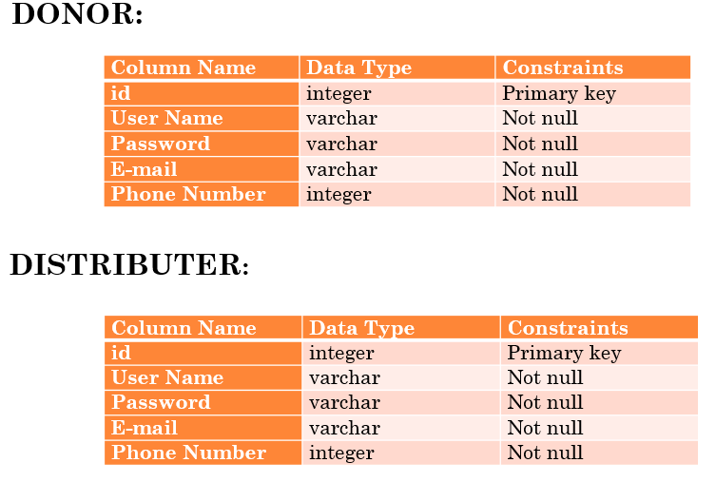
DATASET

Slide 12
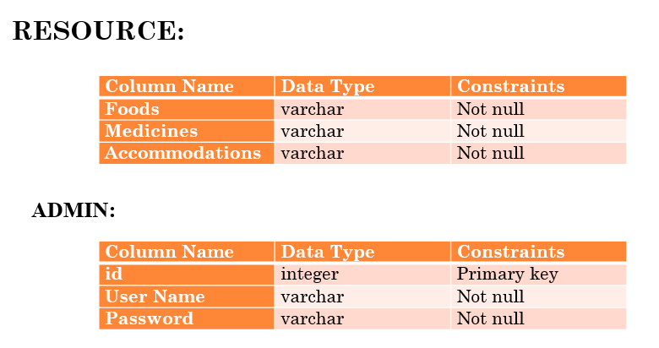
DATASET

Slide 13
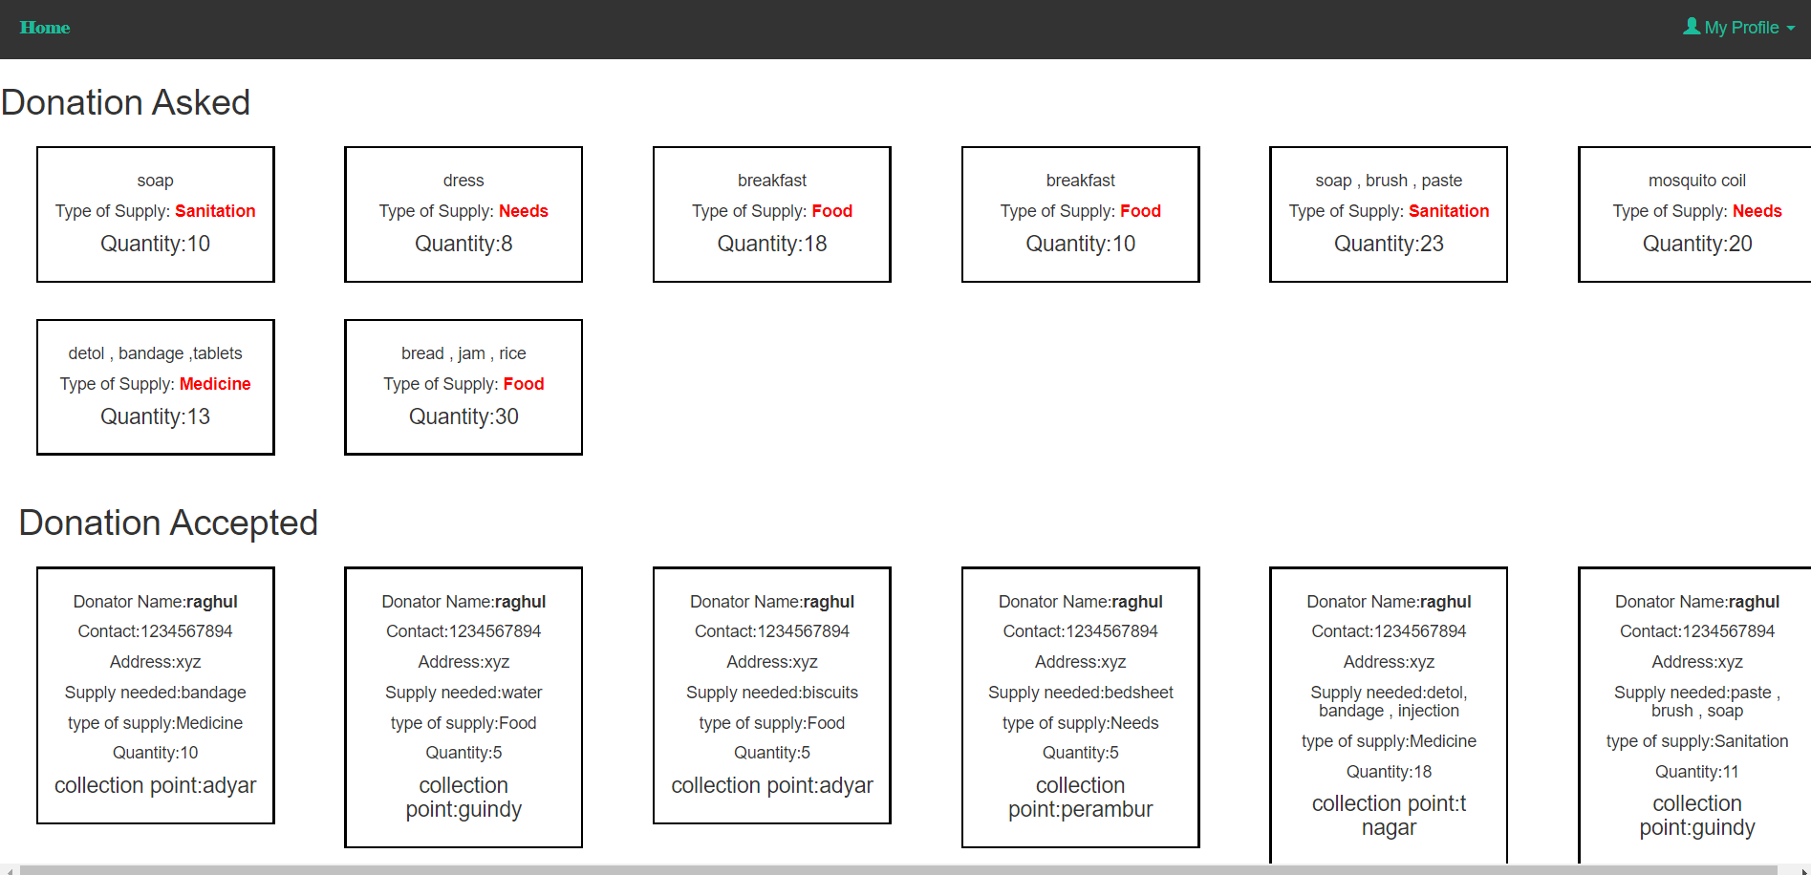
Final output proposed

Slide 14
Conclusion
In the proposed model, we estimated the demand on the basis of the priority level of AAs with the help of information crowdsourcing. However, in case of a large-scale disaster, it is hard to deﬁne the exact amount of demand that will be required at the AAs; hence, it becomes uncertain in nature. Therefore, for future research, we could consider demand as uncertain parameter in the model, and to deal with the in the rent uncertainty, who used that is associated with the parameter . Another scope of future research is the designing of a two-phase optimal transportation plan that is based on blockage of transportation According to the best of our knowledge, no research work has dealt with a two-phase evacuation plan in a disaster, based on blockage of transportation . Sometimes, in a disaster, the blockage of routes in the transport path could occur; this can also be accounted for in the modeling for future research. For a solution to the proposed problem, a different heuristic algorithm can be designed.

